Slide 1
EDA Assignment

Slide 2
Overview
What is EDA?
Why EDA?
History of EDA.
Types of Data.
Steps in EDA.
Types of Analysis
Graphs.
Conclusion.

Slide 3
What is EDA?
Trying to understand data.
It’s an technique to draw inferences and obtain insights from them.
Critical step in any data science activity.
Findings from EDA can completely direct the ML and NON-ML activities.
TBs of data can be analysed using Big data technologies.

Slide 4
Why EDA?
Maximize insights into dataset.
Detect Outliers and anomalies.
Test underlying assumptions.

Slide 5
History of EDA.
Work of Tukey – 1977 (Boxplot)
ABCs of EDA, vellman and Huaglin (1981)
More graphical analysis developed lately

Slide 6
Types of Data (also Exp)
Data Types
Private Data Public Data
Client data isn't easy to get Its not always relevant
Examples - Banking data Examples – Public data Catalogues
Telecom Government Data Website

Slide 7
Steps in EDA
Important Variables
Univariate Analysis
Bivariate Analysis
Data Visualisation
Handling Missing values and outliers.
Transform Original Variables.
Derive New Variables.
Correlation between variables

Slide 8
Types Of Analysis
Univariate analysis.
- It means only One variable at a time.
Bivariate analysis.
- It means only Two variable at a time.
Multivariate analysis
- It means only Multiple variable at a time.

Slide 9
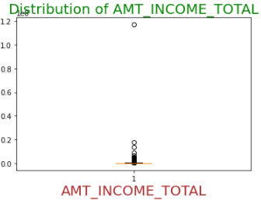
Graphs
Now in assignment we have compared driven some graphs.
The above graph i.e. Box plot which shows the distribution of Income.

Slide 10
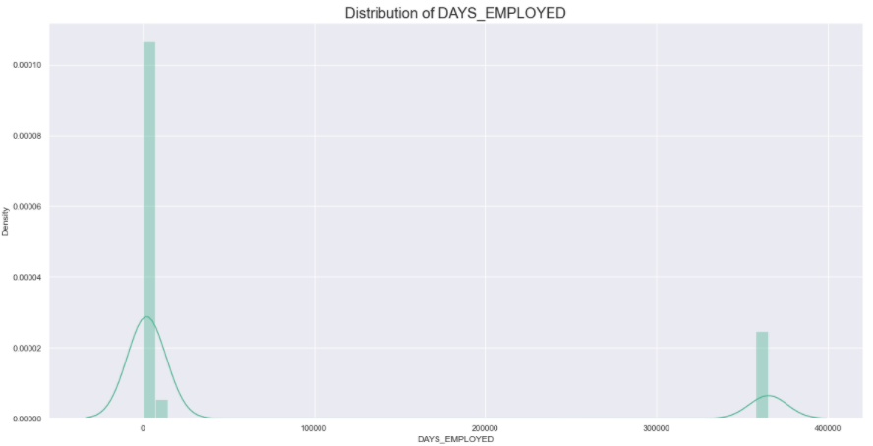
We can also look at this graph below as follows-
This graph comprises of distribution of days employed.

Slide 11
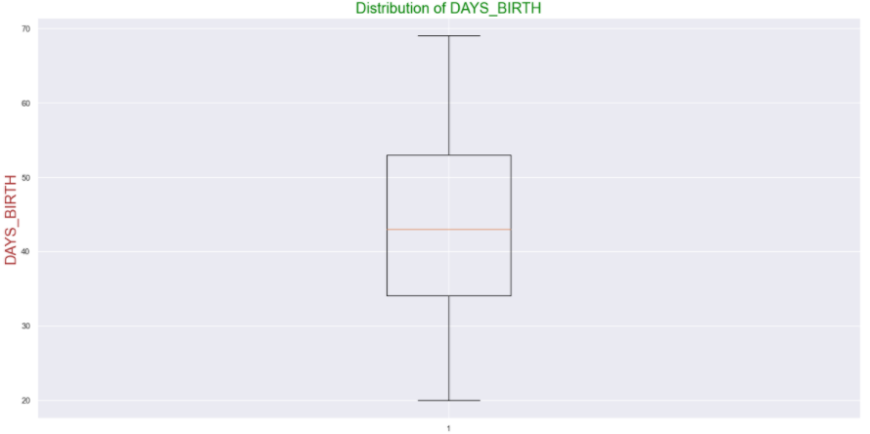
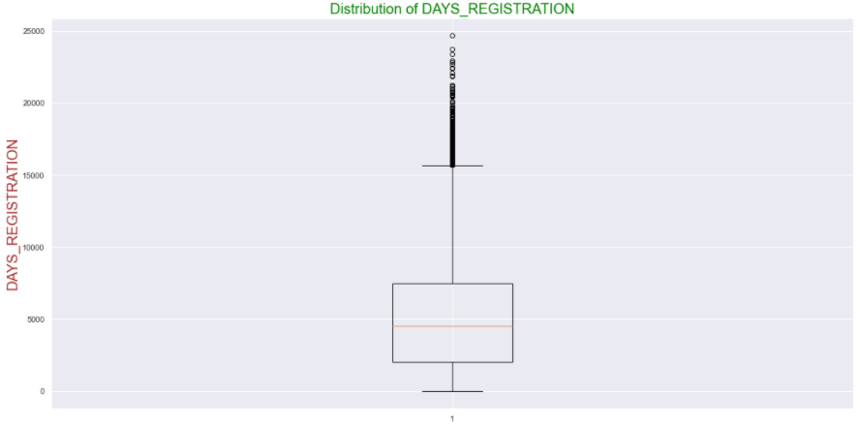
We can also graph two variables called days birth and days registration from the dataset.

Slide 12
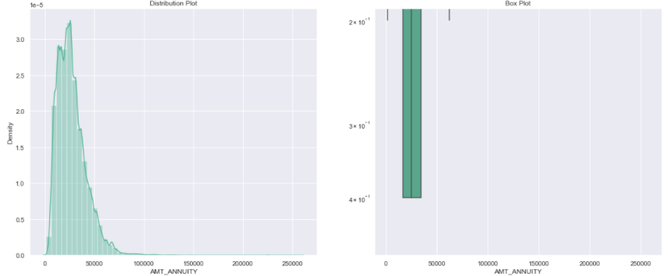
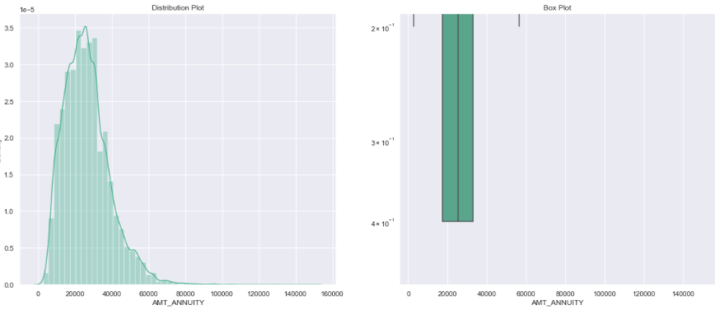
Univariate analysis Graphs
This graphs are on basis of target varaible.
Loan Annuity –
Target0 –
Target1 –

Slide 13
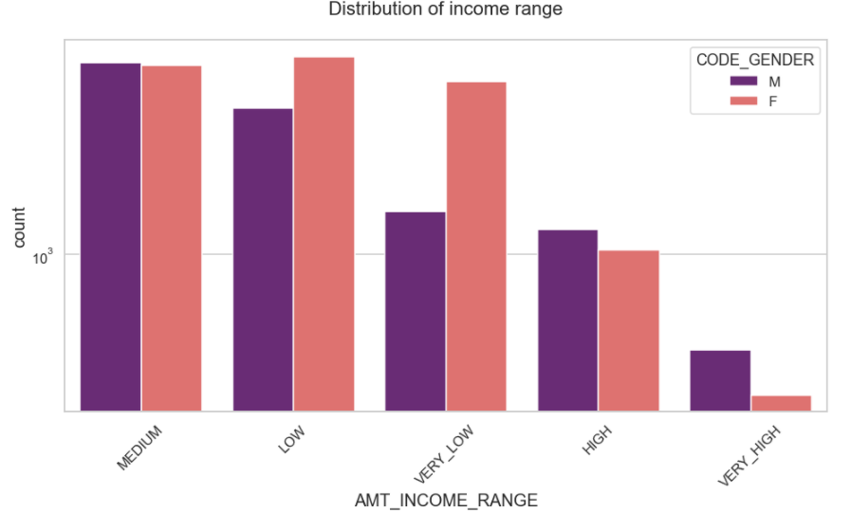
Now we can income distribution between different age.
This where some Graphs shown for univariate analysis.

Slide 15
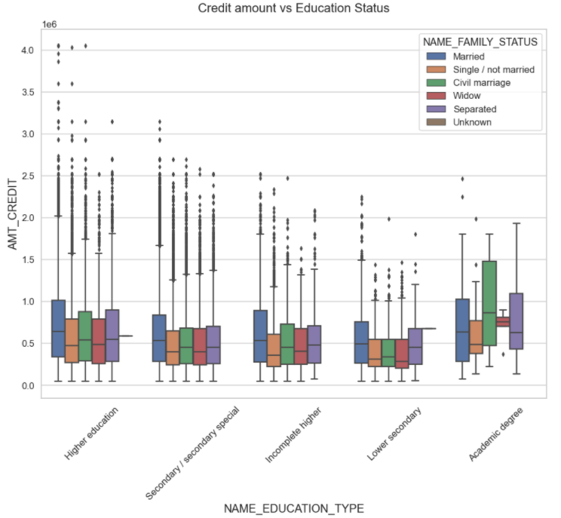
Bivariate analysis
For this we can use box plots and get some graphs.
Below graphs shows data from Target 0 with education type, amount credit and family status variables.

Slide 16
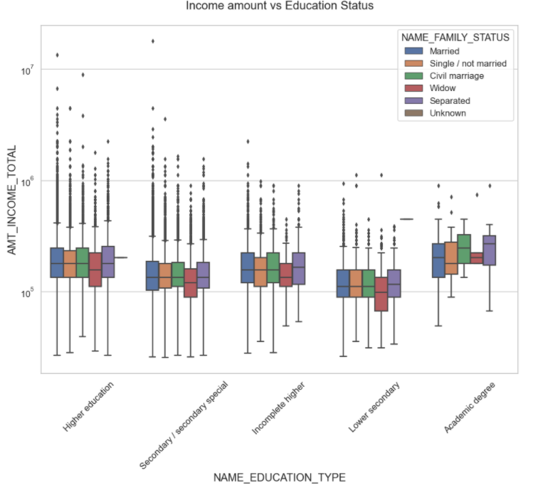
Now same with target 1 data
Above graph clearly shows we can target student area for the maximize profit.

Slide 17
Conclusion
So, now we can conclude that we can target student sector because graphs analysis clearly shows it.
Basically EDA is the major step in analysis and getting analysis is not a big deal but getting important variables deleted can put an analyst in trouble.

